Slide 1
Module 8
Portfolio Project
Renjeev Ramachandran Nair
Colorado State University Global
Course Code: ISM581 – Capstone: Business Intelligence and Data Analytics
Instructor: Justin Bateh
Due Date: 10/09/2022

Slide 2
Introduction
This research paper is aimed to conduct a thorough and detailed evaluation of the diseases data set available in the World Health Organization (WHO) data repository
Helps evaluate the diseases, its causes and the improvements that can be made to the environment to promote the health and sanitation of the required regions.
Focus is to understand the data, identify all the variables within the data set and create models that can help predict mortality rates based on the inputs that we provide.
Notes:
Introduction
This research paper is aimed to conduct a thorough and detailed evaluation of the diseases data set available in the World Health Organization (WHO) data repository. The dataset contains information on the diseases and the mortality rates due to these diseases across the globe. This research helps evaluate the diseases, its causes and the improvements that can be made to the environment to promote the health and sanitation of the required regions. The study will help benefit WHO in understanding the diseases across the globe and the immediate action items they need to perform in different parts of the globe in reducing the spread of diseases and reducing the mortality rates. As part of the research our focus is to understand the data, identify all the variables within the data set and create models that can help predict mortality rates based on the inputs that we provide. As part of the research, we will be focusing on hypothesis and creating models to solve those hypotheses. We wanted to focus on research that could differentiate the mortality rates from Adults to Children. Adults and Child mortality rates are much different, and the underlying reasons can vary significantly. Chronic diseases and heart related issues are major causes for the Adult death rate whereas Malaria, diarrhea and respiratory related illness are major causes for Child death. We also wanted to compare the mortality rates based on economic status to see if this is a significant factor. There could be cases where people in rich economy tend to afford better medical care and balanced diet / nutritions compared to others.

Slide 3
Dataset and Benefits to the organization
Dataset Name : “Mortality rates based on diseases from WHO”
Helps in comprehensive analysis on the different kinds of diseases across the world and the mortality rates and its relations
Consists of information’s about mortality in several parts of the world as well as the diseases / accidents / causes for the same as of the year 2018.
This will help reduce the overall mortality rates and spread of diseases and help WHO to provide care as needed.
Notes:
Dataset and Benefits to the organization
The dataset I selected for this project is from the World Health Organisation (WHO) public data. The name of the data set is “Deaths attributable to the environment by disease and region Estimates”. This dataset contains a lot of information about the different types of diseases across the globe and the mortality rates due to them. There are supporting data available which is very granular and can be used for further analysis and substantiate evidence. The data also contains information on the caused for death , the kind of treatment provided and some high level information’s on the patients’ medical condition. This will help me do a comprehensive analysis on the different kinds of diseases across the world and the mortality rates and its relations. This study will help understand the areas that needs improvements and need for a strong health support systems in certain geographic areas. This also helps in identifying the most dangerous disease around the globe and the actions / preventions that should be in place to avoid them. The dataset consists of information’s about mortality in several parts of the world as well as the diseases / accidents / causes for the same as of the year 2018. The dataset mainly focus on 62 different causes that leads to mortality and have information of the same from different parts of the world. The data has age groups, gender information which would help to analyze the difference in mortality rates from children to adults and male to female. This dataset have good informations on the major causes of death in different parts of the world. By analysing this dataset we can find correlations between these causes and mortality rates as a function of different variables like age, gender, economic situations, political situations etc. We can focus on the causes which are due to simple environmental issues, which can be corrected with healthy living practices and personal hygiene. This study will not only help to reduce the death but also to minimize the expense of global health care system.

Slide 4
Dataset
Diseases across the globe that results in mortality and its rates as of 2018.
Dataset mainly focus on 62 different causes that leads to mortality and have information of the same from different parts of the globe.
Child mortality rates are available in a different file.
There are a total of 62 observations for the approximately 15 different attributes spread across the globe.
Notes:
Dataset Description
The dataset I selected for this project is from the World Health Organisation (WHO) public data. The name of the data set is “Deaths attributable to the environment by disease and region Estimates”. This dataset contains a lot of information about the different types of diseases across the globe and the mortality rates due to them. There are supporting data available which is very granular and can be used for further analysis and substantiate evidence. The data also contains information on the caused for death , the kind of treatment provided and some high level information’s on the patients’ medical condition. This will help me do a comprehensive analysis on the different kinds of diseases across the world and the mortality rates and its relations. This study will help understand the areas that needs improvements and need for a strong health support systems in certain geographic areas. This also helps in identifying the most dangerous disease around the globe and the actions / preventions that should be in place to avoid them. The dataset consists of information’s about mortality in several parts of the world as well as the diseases / accidents / causes for the same as of the year 2018. The dataset mainly focus on 62 different causes that leads to mortality and have information of the same from different parts of the world. The data has age groups, gender information which would help to analyze the difference in mortality rates from children to adults and male to female.

Slide 5
Tools Used to Analyze data
SAS is a statistical tool that can be used for analyzing data through SAS programs.
SAS handles huge dataset and have wide range of statistical functions.
Tableau is a visualization software that can be used to visualize and analyze data visually.
Wide range of visualization techniques that help in doing comparison and analyzing different data samples.
Notes:
Tools and Techniques Used to Analyze dataset
For analyzing this dataset, I will be using SAS and Tableau as my primary tools. SAS is a statistical tool that can be used for analyzing data through SAS programs. Using SAS I am planning to create models and statistical tests that could help prove my hypothesis. I am planning to do Two sample t- tests for my hypothesis statements. Tableau is a visualization software that can be used to visualize and analyse data visually. It has a wide range of visualization techniques that help in doing comparison and analyzing different data samples. I am planning to leverage bubble charts, Scatter plots and bubble plots to analyze the data. This will give a visual representation of relationships between different variables.

Slide 6
Hypothesis Statements
Compare the mortality rates between children and adult.
Ho (Null hypothesis): Mortality rate are not significantly different from children and adults.
Ha (Alternate hypothesis): Mortality rates are significantly different from children and adults.
Check the mortality rates based on Income.
Ho (Null hypothesis): Mortality rates are not significantly different between High income and low-income groups.
Ha (Alternate hypothesis): Mortality rates are significantly different between High income and low-income groups.
Notes:
Hypothesis 1
According to Macleod & Hockey (1981), a hypothesis a formal statement or prediction that is suggested by limited knowledge or observation which yet to prove or disapprove. Hypothesis enables the researchers to evaluate the research statement and main thoughts involved in the research. It is an uncertain statement or prediction about the relationship of two or more variables. It is a testable statement regarding what we can anticipate to happen in a research or study. Usually hypothesis starts with a question, which is then further evaluated and explored through background research.
How are the diseases affecting children and adults? Are there any specific diseases that differs from the way it affects adult’s vs children, and will it significantly impact the mortality rates? This research will help us to understand how each diseases impacts different age groups and what age group can get critically ill due to some diseases. This will help to focus on the age group and care required in case of spread of such diseases.
Ho (Null hypothesis): Mortality rate are not significantly different from children and adults.
Ha (Alternate hypothesis): Mortality rates are significantly different from children and adults.
Next research, we would like to focus on the mortality rates based on income. We wanted to do research to understand if the mortality rates are higher in low-income areas / groups. Low-income group may find it difficult to get proper medical care and nutrition for most of the diseases and probably end up with higher mortality rates. Also certain diseases may need costly treatments which could be affordable only by high income households. Based on this analysis WHO can decide what financial aid/ medical support can be provided in areas with low income.
Ho (Null hypothesis): Mortality rates are not significantly different between High income and low-income groups.
Ha (Alternate hypothesis): Mortality rates are significantly different between High income and low-income groups.

Slide 7
Hypothesis Statements
3. Geographical significance on the mortality rates due to diseases.
Ho (Null hypothesis): Mortality rates are not significantly different between America and Europe
Ha (Alternate hypothesis): Mortality rates are not significantly different between America and Europe.
4. Political Status affecting the mortality rates.
Ho (Null hypothesis): Mortality rates are not significantly different between developed and developing/underdeveloped nations.
Ha (Alternate hypothesis): Mortality rates are significantly different between developed and developing/underdeveloped nations.
Notes:
Hypothesis 2
There is a need to do research on the mortality rates between different geographical regions. While considering these geographic regions we need to make sure these regions are economically similar and have good medical support and infrastructure. To understand the geographical impact on diseases we should consider two developed regions and compare the mortality rates. For this research we can consider America and Europe’s mortality rates. They are developed nations and have advanced in medical fields and offer good health care benefits. Comparing these regions would be ideal to understand geographical implications on the mortality rates.
Ho (Null hypothesis): Mortality rates are not significantly different between America and Europe
Ha (Alternate hypothesis): Mortality rates are not significantly different between America and Europe.
As part of this research, we also need to understand how the infrastructure and political situations in a country affects the mortality rates. A developed nation with a good medical infrastructure and health care facilities may have a low mortality rate compared to a developing/ underdeveloped nation, where health care systems are not developed / given much importance. This will help WHO to understand the diseases where they have to provide much focus on the underdeveloped nations.
Ho (Null hypothesis): Mortality rates are not significantly different between developed and developing/underdeveloped nations.
Ha (Alternate hypothesis): Mortality rates are significantly different between developed and developing/underdeveloped nations.

Slide 8
Statistical Test Performed
Hypothesis testing done using two sample T-Test.
Best method to compare two independent variables.
Tableau offers wide range of data visualization and analysis.
Bubble charts and bubble plots used to analyze data.
Notes:
Statistical test
For analyzing this dataset, I will be using SAS and Tableau as my primary tools. SAS is a statistical tool that can be used for analyzing data through SAS programs. Using SAS I am planning to create models and statistical tests that could help prove my hypothesis. I am planning to do Two sample t- tests for my hypothesis statements. Tableau is a visualization software that can be used to visualize and analyze data visually. It has a wide range of visualization techniques that help in doing comparison and analyzing different data samples. I am planning to leverage bubble charts, Scatter plots and bubble plots to analyze the data. This will give a visual representation of relationships between different variables.

Slide 9
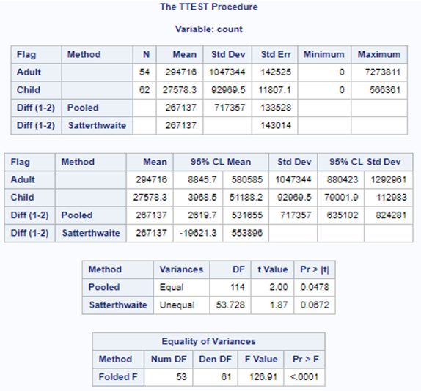
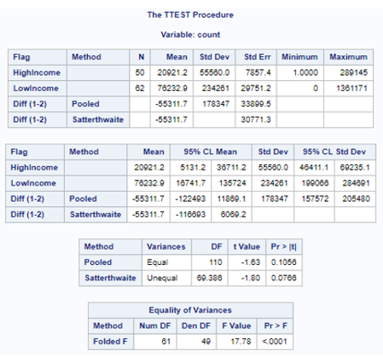
Statistical Test - Result
P values of 0.047 lesser than the alpha value of 0.05 for hypothesis 1
For hypothesis 2 there is no significant difference.
Notes:
Statistical test
The figure shows the output of SAS procedure, we can see that there are 62 observations in the file. The means and standard deviation for adult and children in the data set are shown in the result. The total mean for adult record is 176043 and child record is 27578.3 Here the P value is .0150 and value for degree freedom is 122. Here the P value is .0150 which is less than the alpha value .05.
Based on the P values of 0.047 lesser than the alpha value of 0.05, we can reject the null hypothesis and can consider that the mortality rates is significantly different between child and adults.

Slide 10
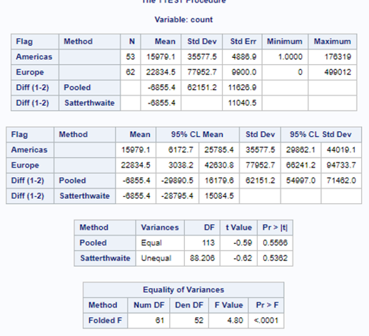
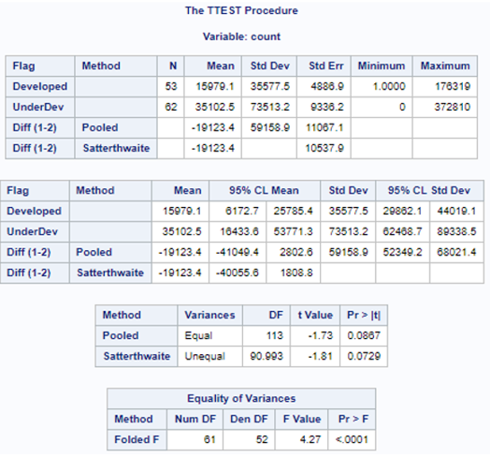
Statistical Test - Result
For hypothesis 2 there is no significant difference.
considerable difference in mortality rates between developed / underdeveloped nations
Notes:
Statistical test
Mortality rates is significantly different between child and adults.
Adults mortality rates are higher due to heart related issues where as kids suffer from diseases mainly due to environmental issues and sanitation problems.
There is no significance difference between high value / low value income
No significant difference between the mortality rates of developed countries
Considerable difference in mortality rates between developed / underdeveloped nations
Causes are due to lack of hygiene and proper education.

Slide 11
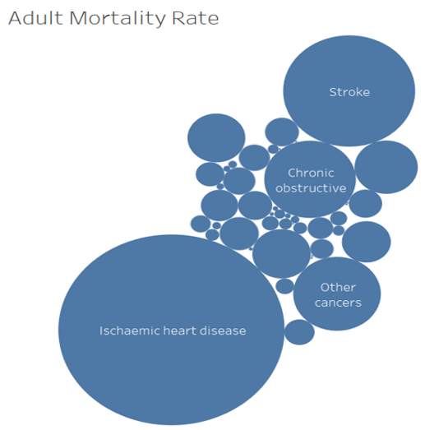
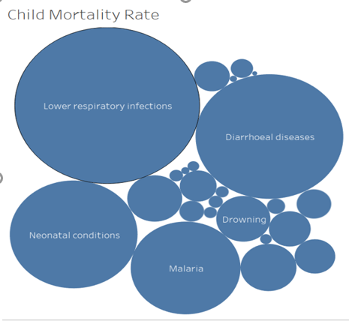
Dashboard Visuals
Analysis is done using bubble charts.
Sanitary issues are main cause of Child mortality rates
Heart related issues are main cause for Adults.
Notes:
Tableau Dashboard Report
Here we have used bubble chart in Tableau to visualize the mortality rate between child and adults. A bubble plot is an extension of the scatter plot used to visualize the relationships between variables. The Tableau report shows that the main cause of mortality in children are diarrheal diseases and lower respiratory infections where in adults are Ischemic heart disease and Stroke.
The Tableau reports clearly shows that’s adult mortality rates are much higher compared to Children. Also the major death causes are different between Adults and kids. Adults mortality rates are higher due to heart related issues where as kids suffer from diseases mainly due to environmental issues and sanitation problems.

Slide 12
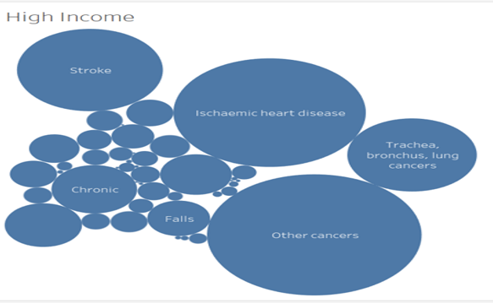
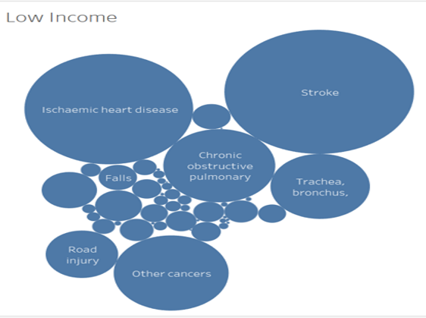
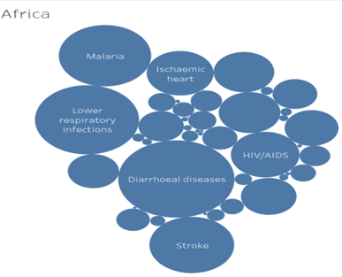
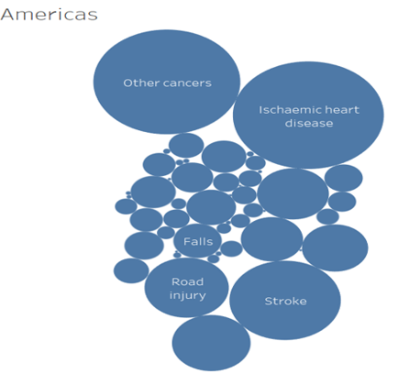
Dashboard Visuals
Notes:
Tableau Dashboard Report
Both high income / low income groups are affected by similar diseases and there is no significant differences between them. The health facilities and infrastructure are efficient through out the country and all income group are getting proper medical care.
Based on the tableau dashboards there are no significant difference between regions of similar development and economic status. The major differences that we can find is America have a higher Road accident count compared to Europe mainly because of the high speed freeways in the country.
The results shows that there is considerable difference in mortality rates between developed / underdeveloped nations

Slide 13
Hypothesis Test – Findings
Mortality rates is significantly different between child and adults.
Adults mortality rates are higher due to heart related issues where as kids suffer from diseases mainly due to environmental issues and sanitation problems.
There is no significance difference between high value / low value income
No significant difference between the mortality rates of developed countries
Considerable difference in mortality rates between developed / underdeveloped nations
Causes are due to lack of hygiene and proper education.
Notes:
Hypothesis Test – Findings
In underdeveloped nations there is a lot more mortality due to the environmental pollutions and hazards. Disease like Diarrhea, Malaria and respiratory issue are some of the common causes. HIV is another main cause. These are due to lack of hygiene and proper education. This could be a significant action item for WHO to look into underdeveloped nations and the causes for the mortality.

Slide 14
Recommendations and Conclusion
Expand the study based on the patient history and underlying conditions.
Geographical factors are of not real significant differences.
Nations infrastructure and medical support system plays a vital role in the mortality rates
Proper sanitization methods and practicing some social distancing can help reduce mortality rates significantly.
Notes:
Factors Influenced the Results & Recommendations
The results are not backed by detailed level patient history and any underlying conditions. This would have skewed the results a little bit and something that needs to be looked into while doing a detailed study. The research helps in understanding many factors and where WHO has to focus on for lowering the deaths caused by various causes. Its safe to conclude that geographical factors are of not real significant differences but the nations infrastructure and medical support system plays a vital role in the mortality rates. Also children’s mortality rates are very low compared to adults and the children’s mortality rates can be improved by proper sanitization methods and practicing some social distancing.

Slide 15
References
WHO. (2016). Preventing disease through healthy environments. Retrieved from https://apps.who.int/iris/bitstream/handle/
Khan A, Plana-Ripoll O, Antonsen S, Brandt J, Geels C, & Landecker H. et al. (2019). Environmental pollution and risks. https://doi.org/10.1371/journal.pbio.3000353
Tableau. (2012). Dashboards. Retrieved from https://help.tableau.com/current/pro/desktop/en-us/dashboards.htm
Galiani, S. & Galvez, R. H. (2017). The Life Cycle Scholarly Articles Across Fields of Research. National Bureau of Economic Research. https://doi.org/10.3386/w23447
Barbara Lawler (2019). Five global trends in data ethics and privacy in 2019. Retrieved from https://looker.com/blog/big-data-ethics-privacy
O’Leary, Z. (2021). The essential guide to doing your research project.
Ed Moyle. (2018). Tools: Data Protection Tools. Retrieved from https://www.isaca.org/resources/isaca-journal/issues/2018/volume-1/tools-data-protection-tools

